Slide 1
INTRODUCTION TO TRIGONOMETRY
Module 2 of 3
Ratna Rathor
AECS 2
Mumbai

Slide 2
Trigonometric Ratios of Some Specific Angles

Slide 3
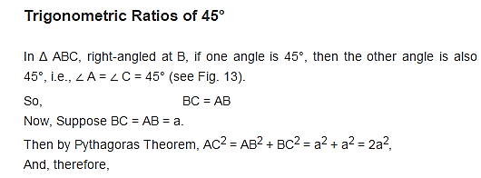
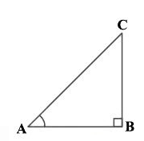
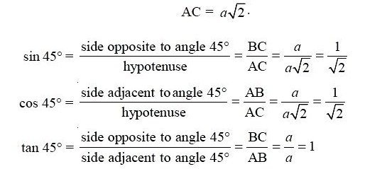
Finding the value of Trigonometric Ratio of 45°

Slide 4
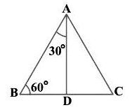

Slide 5
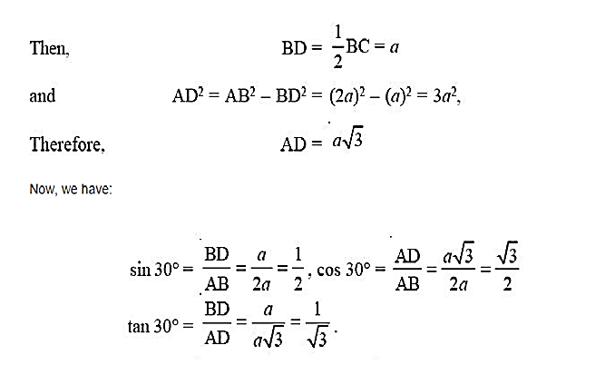

Slide 6
Similarly

Slide 7
Trigonometric Ratios of 0° & ° 90° Case I – When angle A is 0°
Notes:
0° 90°

Slide 8
Case II – When angle A is 90°

Slide 9
Standard values of Trigonometric ratios
∠A | 0º | 30º | 45º | 60º | 90º
sin A | 0 | 1/2 | 1/√2 | √3/2 | 1
cos A | 1 | √3/2 | 1/√2 | 1/2 | 0
tan A | 0 | 1/√3 | 1 | √3 | not defined
cosec A | not defined | 2 | √2 | 2/√3 | 1
sec A | 1 | 2/√3 | √2 | 2 | not defined
cot A | not defined | √3 | 1 | 1/√3 | 0

Slide 10
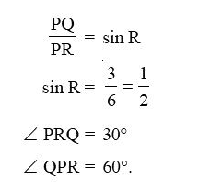
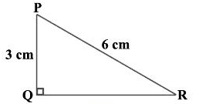
Example :-
In Δ PQR, right-angled at Q, PQ = 3 cm and PR = 6 cm. Determine
∠ QPR and ∠ PRQ.

Slide 11
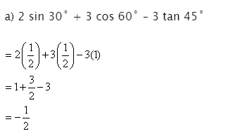
Example :-Evaluate the following
Solution :-

Slide 12
THANK YOU

